Slide 1
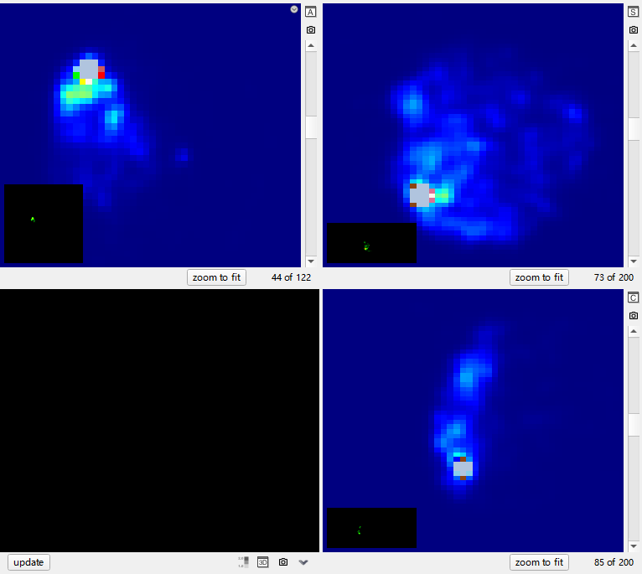
S1P26
Lesion4

Slide 2
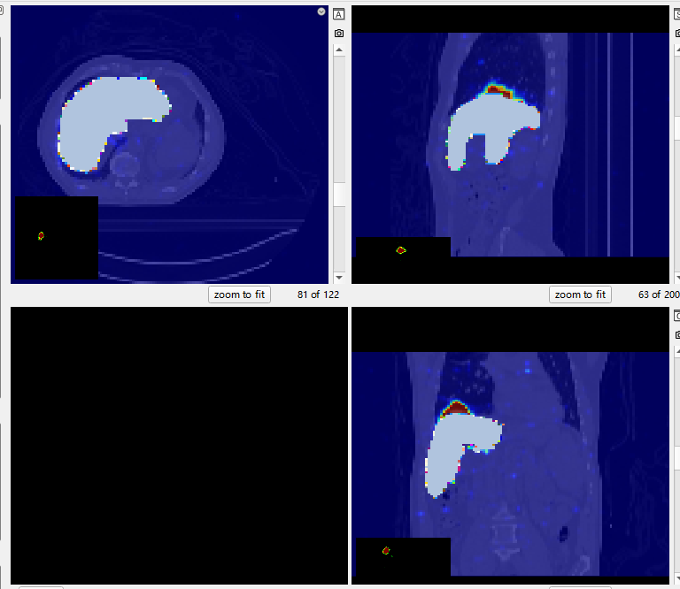
S1P46
Healthy liver

Slide 3
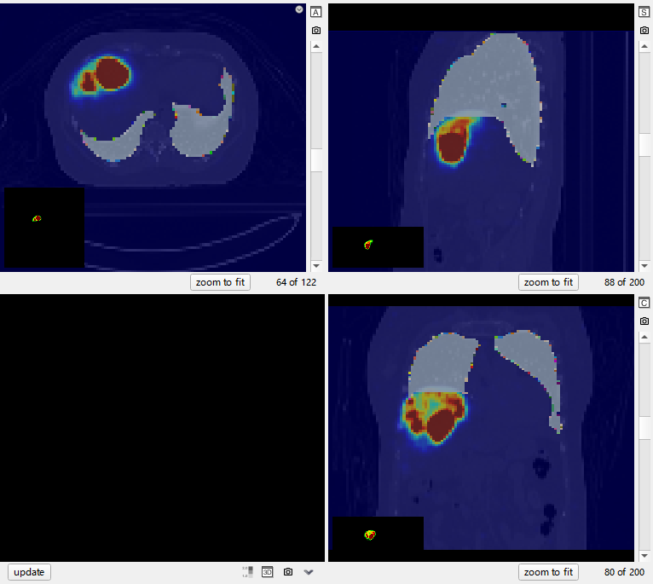
S1P70
LUNG

Slide 4
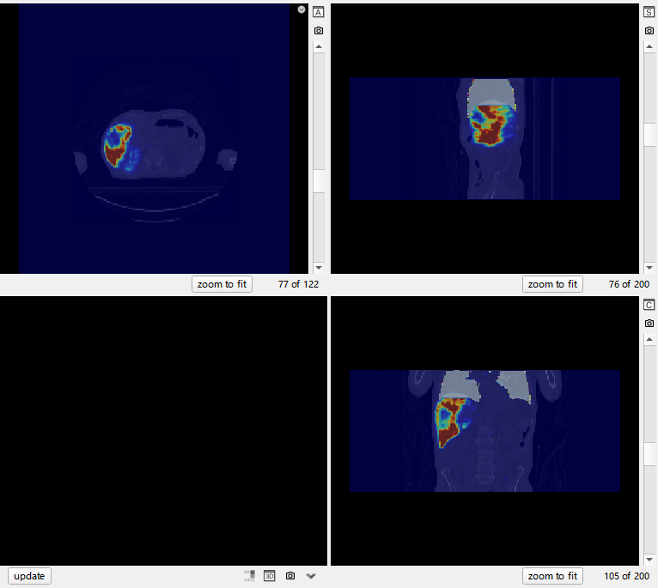
S1P77
LUNG

Slide 5
